Slide 1
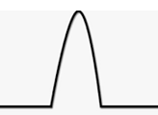


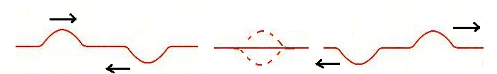
Standing Waves and Resonance Lesson
Recap: Pulse Interference
When two UP pulses or CRESTS meet in a spring they produce a ____________ and then pass through.
supercrest
Before During After
Constructive
Interference
bigger amplitude
When an UP and a DOWN pulse meet in a spring they momentarily____________ and then pass through.
cancel
Before During After
Destructive
Interference
smaller amplitude

Slide 2
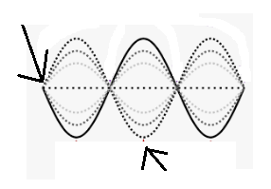
Standing Waves:
Node-destructive interference always
A special form of wave interference occurs when travelling waves with the same __________________ and _________________ interfere.
The resulting wave appears to be stationary with fixed ______________ between with vibrating _________________.
amplitude
wavelength
Loop or Antinode-
Destructive/constructive interference
nodes
loops

Slide 3
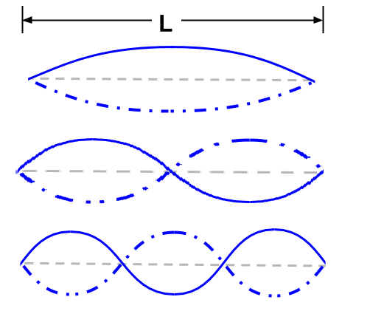


Number of Loops:
You can increase the number of loops for a standing wave by ___________ the frequency of vibration!
increasing
The node to node distance is one half wavelength!
1 loop
2 loops
Δd_{n} = $\frac{λ}{2}$
3 loops
Δd_{n}

Slide 4
Standing Wave Analysis:
Standing waves are helpful as they allow us to easily measure ________________.
wavelength
Example: A 4-loop standing wave is produced in a spring 3.00 m long. If the frequency of vibration is 8.00 Hz, find the wavelength and wave speed.
Answer: 1.50 m, 12.0 m/s

Slide 5
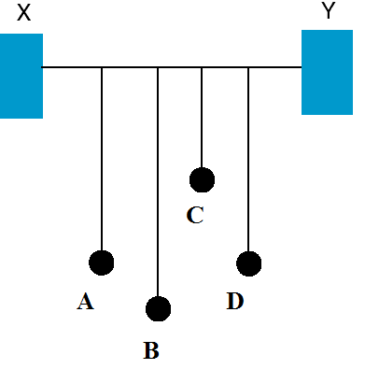


Resonance
Demonstration: What will happen when pendulum A is set in motion?
All vibrate a little, BUT D vibrates A LOT.
D takes up the energy as it is matched in frequency with A!

Slide 6
Resonance
Standing waves are examples of a resonance phenomenon!
Resonance: the transfer of energy to an object at the natural or resonant frequency of the object.
matched
Because the input energy is __________ to the natural frequency of the object, it is able to develop _______________________
vibrations!
large amplitude

Slide 7
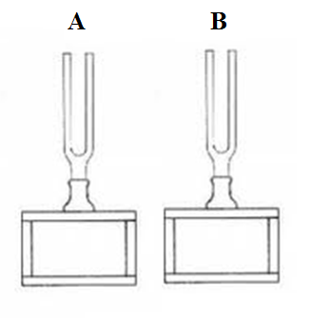
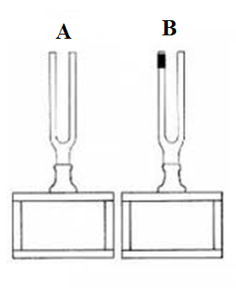

Matched Tuning Forks
Demo 2: A and B are matched (identical frequency). What happens when A is struck?
B vibrates too!
Demo 3: B is now loaded so that has a lower frequency, what happens when A is struck?
B does not vibrate!
Matched tuning fork demonstration

Slide 8
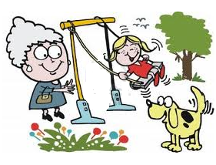
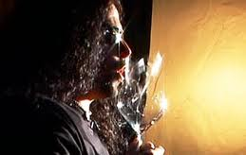
Examples of Resonance:
Pushing a child on a swing
Shattering a wine glass with a voice
Windows on a car rattling when driving at a certain speed
Shattering a wine glass with your voice!
The Tacoma Narrows Bridge collapse!
Classwork Homework:
Read Pages 315-316 Questions: #10 , 11,13 pg 317
Tacoma narrows bridge collapse video…

